Slide 1
Pathlib Module in Python
DVT101 – Lecture 49
- By Dataverse Tutorials

Slide 2
Introduction to Pathlib Module
What is pathlib module
Why it was introduced in Python
Difference between traditional path handling and pathlib
Real-world motivation

Slide 3
Problems with String-Based Paths
Paths as plain strings
Manual path joining issues
OS-specific separators
Common beginner mistakes

Slide 4
Why Pathlib is Better
Object-oriented path representation
Cleaner and readable syntax
Cross-platform compatibility
Reduced error-prone operations

Slide 5
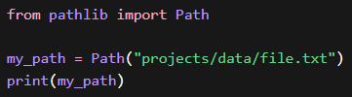
Understanding Path Objects
Path as an object, not string
Path representing files and directories
Lazy behavior vs actual filesystem access
Core philosophy of pathlib

Slide 6
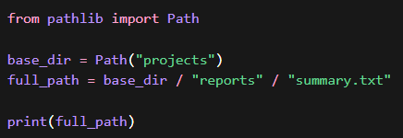
Importing and Using Path Class
Path as the main entry point
How Path adapts to OS automatically
Relation with WindowsPath and PosixPath
When Path touches filesystem

Slide 7
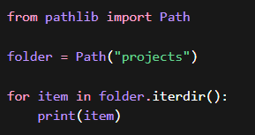
Directory Listing Concept
Traversing directory contents
Difference between files and folders
Iterative directory scanning
Use cases in automation

Slide 8
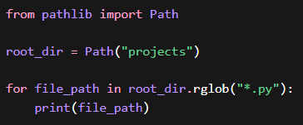
Recursive File Searching
Need for recursive search
File pattern matching concept
Difference between shallow and deep scan
Use cases in large projects

Slide 9
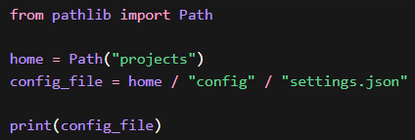
Path Navigation Using Operator Overloading
Meaning of operator overloading
Using / for joining paths
Cleaner alternative to string concatenation
Cross-platform behavior

Slide 10
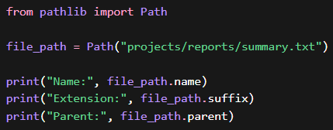
Querying Path Properties
Absolute vs relative paths
File name extraction
File extension and suffix concept
Parent directory navigation

Slide 11
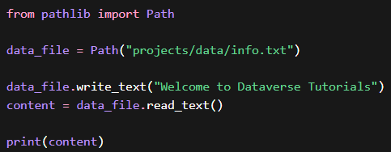
File Reading and Writing Concept
File handling through Path objects
Difference from traditional open()
Automatic path resolution
Cleaner file workflows

Slide 12
Pure Paths vs Concrete Paths
What are Pure Paths
What are Concrete Paths
Filesystem interaction difference
Use-case based selection

Slide 13
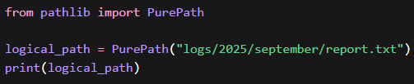
PurePath Class Concept
Path manipulation without filesystem
Cross-platform string safety
When PurePath is preferred
Limitations of PurePath

Slide 14
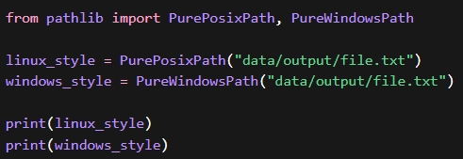
PurePosixPath and PureWindowsPath
OS-specific path representation
Platform-independent development
When to simulate another OS path
Testing and tooling use cases

Slide 15

Concrete Path Classes
Concrete paths touching real filesystem
Reading, writing, checking files
Difference from pure paths
Real execution impact

Slide 16
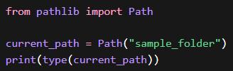
Path, PosixPath, WindowsPath
Automatic class selection
OS-dependent behavior
Inheritance hierarchy intuition
Practical relevance

Slide 17

Getting Current Working Directory
Path-based CWD concept
Difference from os.getcwd()
Project-relative execution
Debugging benefits

Slide 18
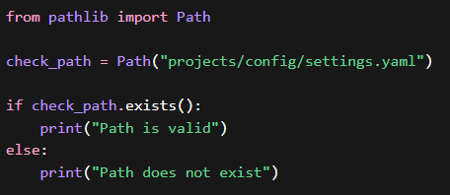
Path Existence and Validation
Why existence check matters
Preventing runtime failures
Safe scripting practices
Validation-first approach

Slide 19
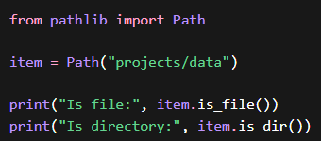
Directory and File Type Checks
Checking directory vs file
Avoiding wrong operations
Safer automation logic
Real-world script reliability

Slide 20
Real-World Industry Use Cases
Data science pipelines
Backend applications
DevOps and automation scripts
Cross-platform tools

Slide 21
Summary & Key Takeaways
Why pathlib is modern Python way
Key advantages recap
When to use pathlib over os.path
Transition to hands-on coding

Slide 22


